Slide 1
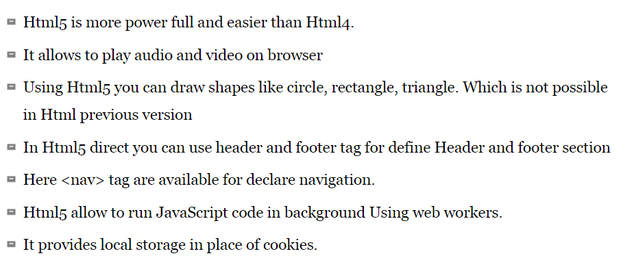
Introduction to HTML and HTML5 SESSION-1

Slide 2
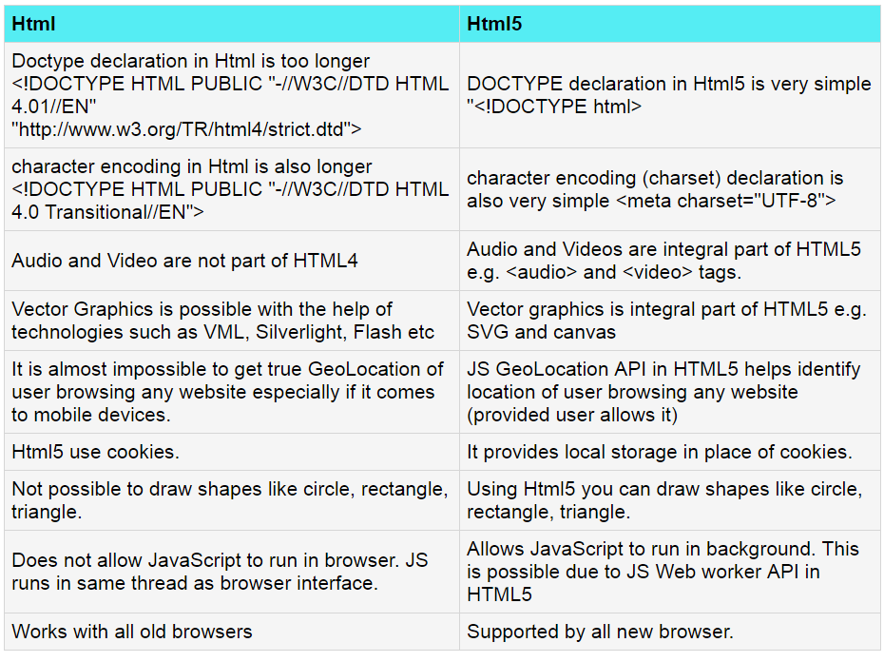
Introduction to HTML and HTML5 SESSION-1

Slide 3
HTML <!DOCTYPE> Declaration
<!DOCTYPE html> <html> <head> <title>Title of the document</title> </head> <body> The content of the document...... </body> </html> o/p The content of the document...

Slide 4
<!DOCTYPE>
The <!DOCTYPE> declaration is not an HTML tag;
it is an instruction to the web browser about what version of HTML the page is written in.
Always add the <!DOCTYPE> declaration to your HTML documents, so that the browser knows what type of document to expect.
The <!DOCTYPE> declaration is NOT case sensitive.

Slide 5
Marquees
An HTML marquee is a scrolling piece of text displayed either horizontally across or vertically down your webpage depending on the settings. This is created by using HTML <marquees> tag.
Syntax
A simple syntax to use HTML <marquee> tag is as follows:
<marquee attribute_name="attribute_value"....more attributes>
One or more lines or text message or image
</marquee>

Slide 6
Example
<!DOCTYPE html>
<html>
<head>
<title>HTML marquee Tag</title>
</head>
<body>
<marquee direction="right">This text will scroll from left to right</marquee>
</body>
</html>

Slide 7
HTML BLOCKS
All the HTML elements can be categorized into two categories (a) Block Level Elements (b) Inline Elements
Block Elements
Block elements appear on the screen as if they have a line break before and after them. For example the <p>, <h1>, <h2>, <h3>, <h4>, <h5>, <h6>, <ul>, <ol>, <dl>, <pre>, <hr />, <blockquote>, and <address> elements are all block level elements.
Inline Elements
Inline elements, on the other hand, can appear within sentences and do not have to appear on a new line of their own. The <b>, <i>, <u>, <em>, <strong>, <sup>, <sub>, <big>, <small>, <li>, <ins>, <del>, <code>, <cite> elements are all inline elements.

Slide 8
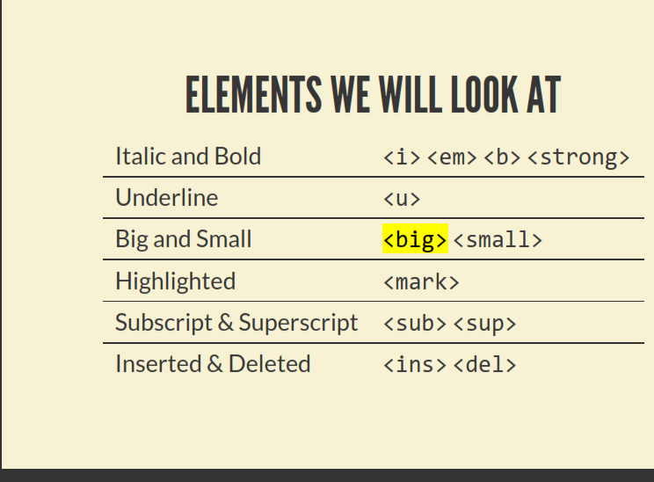
FORMATTING HTML TEXT
.

Slide 9
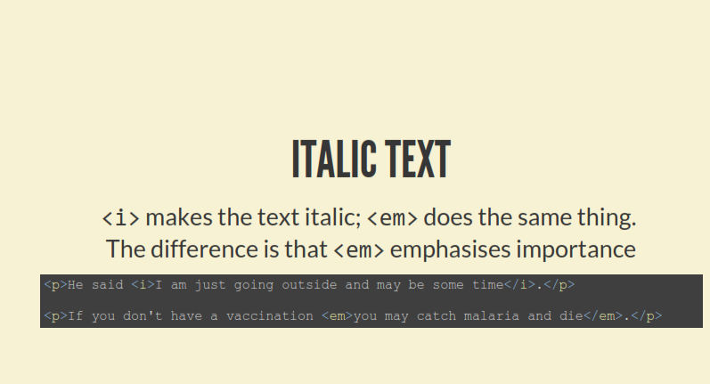

Slide 10
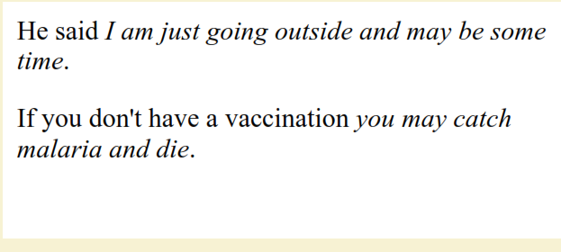

Slide 11
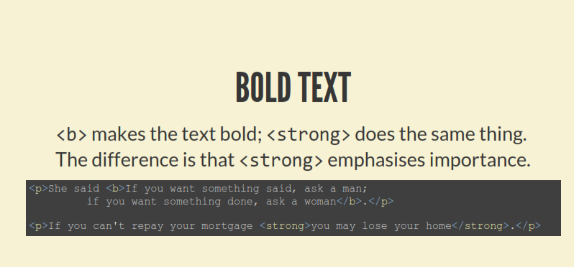
FORMATTING TEXT -BOLD TEXT

Slide 12
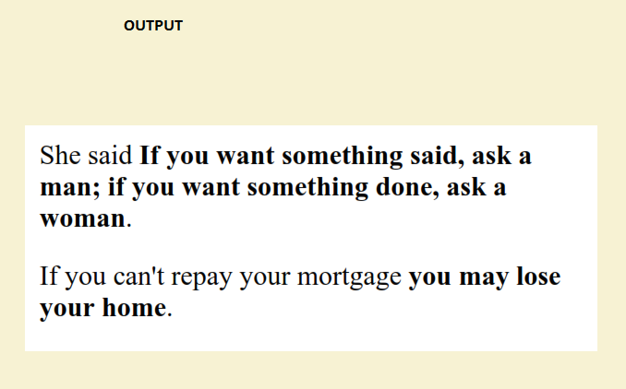

Slide 13
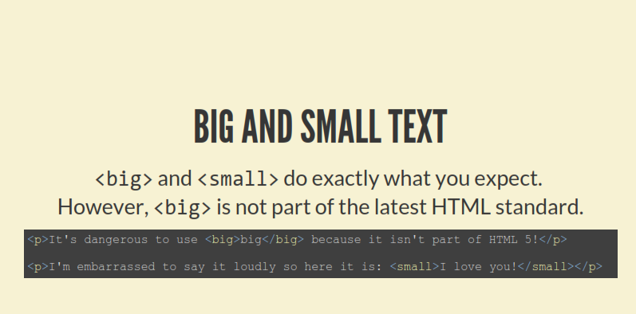

Slide 14
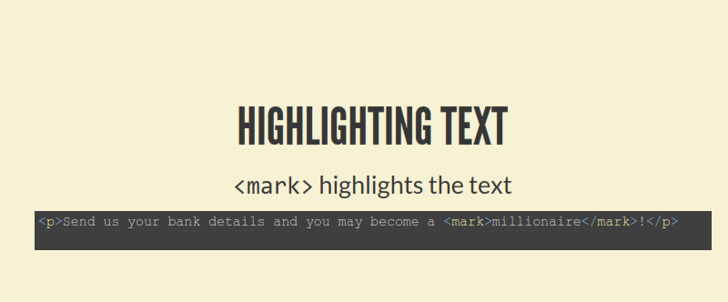
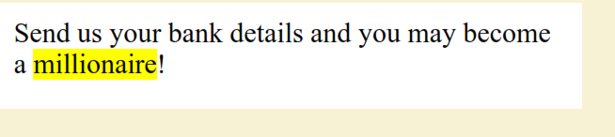

Slide 15
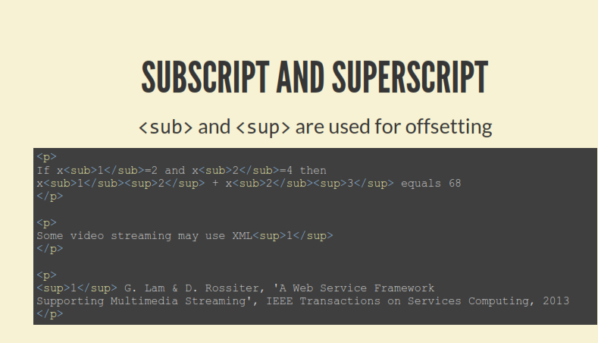
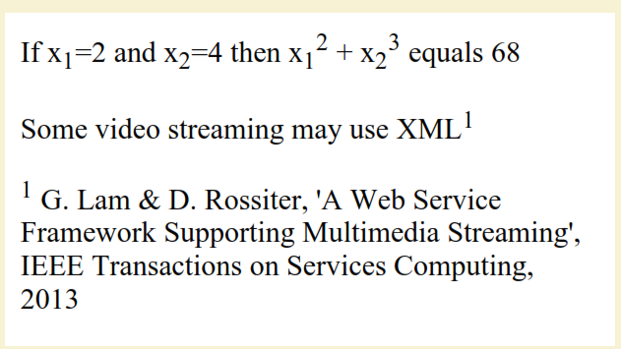

Slide 16
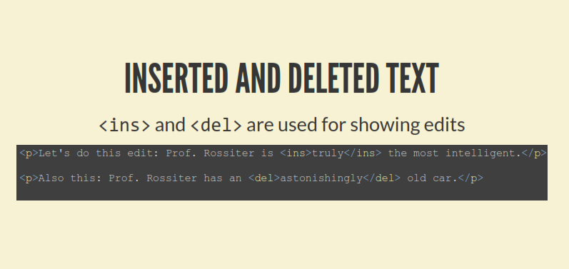
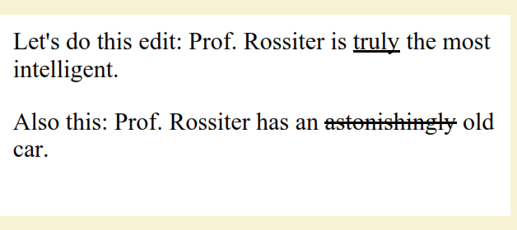

Slide 17
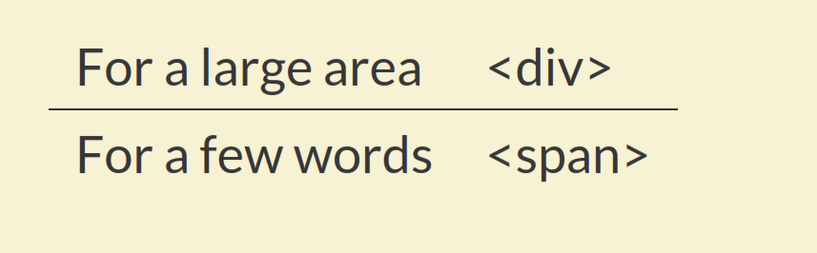
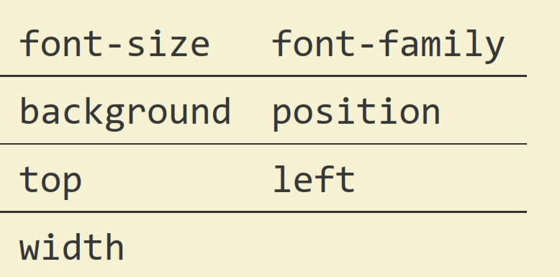
<div> &<span>
STYLE PROPERTIES

Slide 18
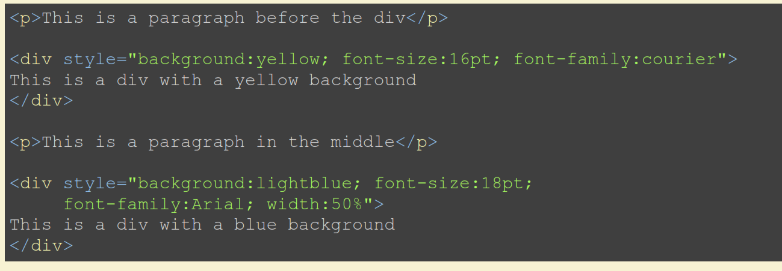
Example <div>

Slide 19
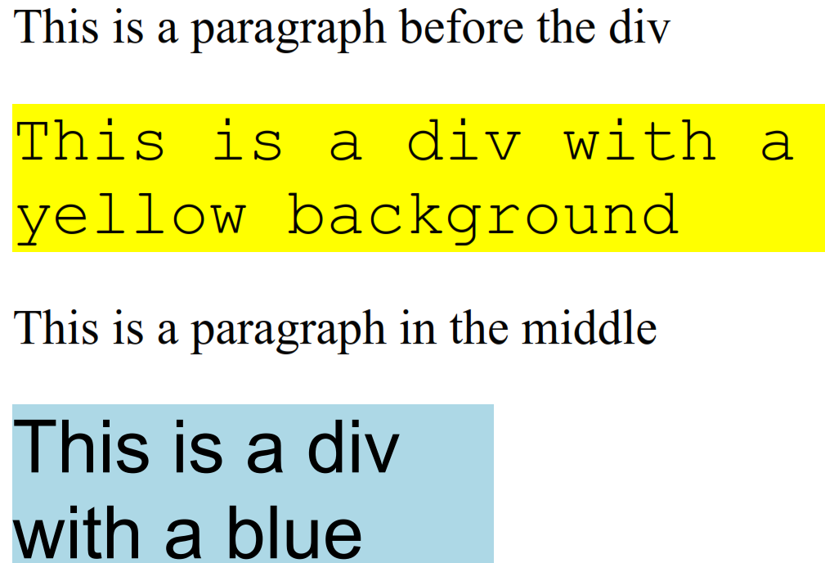
output

Slide 20
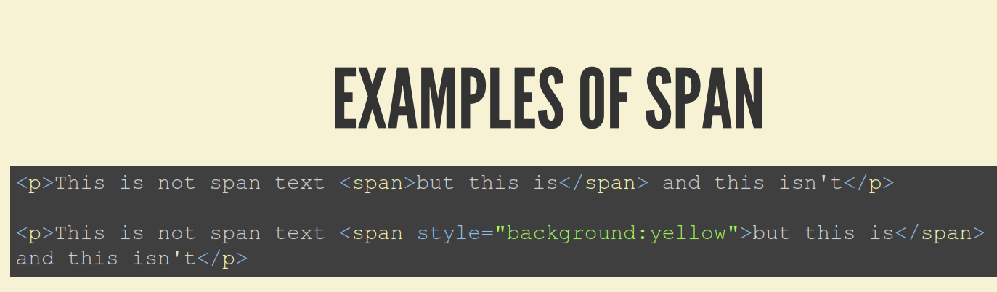
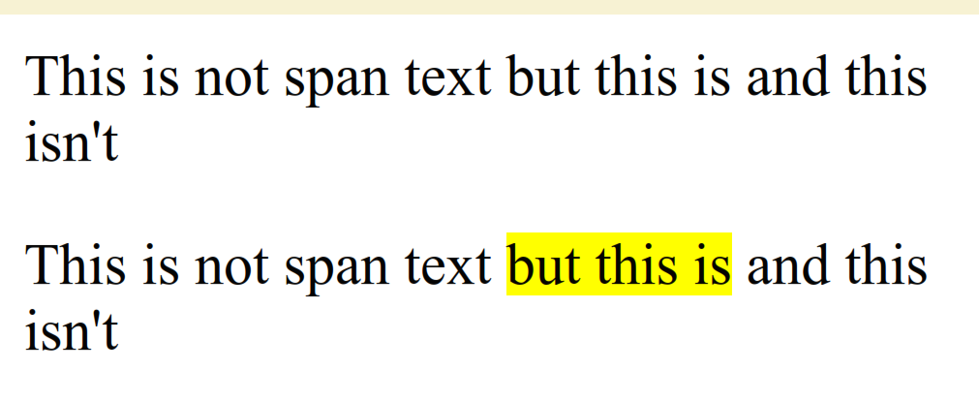

Slide 21
Fonts
HTML <font> tag to add style, size, and color to the text on your website.
The font tag is having three attributes called size, color, and face to customize your fonts. To change any of the font attributes at any time within your webpage, simply use the <font> tag. The text that follows will remain changed until you close with the </font> tag. You can change one or all of the font attributes within one <font> tag.
<font>………………………………..</font>
Set Font Size
You can set content font size using size attribute. The range of accepted values is from 1(smallest) to 7(largest). The default size of a font is 3.

Slide 22
Specify the font size, font face and color of text:
<font size="3" color="red">This is some text!</font> <font size="2" color="blue">This is some text!</font> <font face="verdana" color="green">This is some text!</font>
OUTPUT This is some text!
This is some text!
This is some text!
Note: The font element is not supported in HTML5. Use CSS instead.

Slide 23
Comments-single line & multiline comments
Comment is a piece of code which is ignored by any web browser.
HTML comments are placed in between <!-- ... --> tag
Example
!DOCTYPE html>
<html>
<head> <!-- Document Header Starts -->
<title>This is document title</title>
</head> <!-- Document Header Ends -->
<body>
<p>Document content goes here.....</p>
</body>
</html>
This will produce following result without displaying the content given as a part of comments:
No space allowed between the left angle bracket and the exclamation mark.
o/p -→Document content goes here.....

Slide 24
Multiline Comments
HTML supports multi-line comments as well.
you can comment multiple lines by the special beginning tag
<!-- and ending tag --> placed before the first line and end of the last line
Example
<!DOCTYPE html><html>
<head>
<title>Multiline Comments</title>
</head>
<body>
<!--
This is a multiline comment and it can
span through as many as lines you like.
-->
<p>Document content goes here.....</p>
</body>
</html>
This will produce following result:
O/p ->Document content goes here...

Slide 25
IMAGE
Images are very important to beautify as well as to depict many complex concepts in simple way on your web page.
Insert Image
You can insert any image in your web page by using <img> tag. Following is the simple syntax to use this tag.
<img src="Image URL" ... attributes-list/>
The <img> tag is an empty tag, which means that it can contain only list of attributes and it has no closing tag.

Slide 26
Images
<IMG>This element defines a graphic image on the page.
Image File (SRC:source): This value will be a URL (location of the image) E.g. http://www.domain.com/dir/file.ext or /dir/file.txt.
Alternate Text (ALT): This is a text field that describes an image or acts as a label. It is displayed when they position the cursor over a graphic image.
Alignment (ALIGN): This allows you to align the image on your page.

Slide 27
Images
Width (WIDTH): is the width of the image in pixels.
Height (HEIGHT): is the height of the image in pixels.
Border (BORDER): is for a border around the image, specified in pixels.
HSPACE: is for Horizontal Space on both sides of the image specified in pixels. A setting of 5 will put 5 pixels of invisible space on both sides of the image.
VSPACE: is for Vertical Space on top and bottom of the image specified in pixels. A setting of 5 will put 5 pixels of invisible space above and bellow the image.

Slide 28
Some Examples on images
1) <IMG SRC=“jordan.gif“ border=4>
2) <IMG SRC=" jordan.gif" width="60" height="60">
3) <IMG SRC=“jordan.gif" ALT="This is a text that goes with the image">
4) <IMG SRC=" jordan.gif “ Hspace="30" Vspace="10" border=20>
5) < IMG SRC =" jordan.gif“ align="left">
blast blast blast blast blast

Slide 29
HOW TO MAKE A LINK
1) The tags used to produce links are the <A>
and </A>. The <A> tells where the link should start and
the </A> indicates where the link ends.
2) The example below shows how to make the word
Here work as a link to yahoo.
Click <A HREF="http://www.yahoo.com">here</A> to
go to yahoo.
Image as Link :
<a href="default.asp“><img src="smiley.gif" alt="HTML tutorial" style="width:42px;height:42px;border:0“></a>

Slide 30
Images
Set Image Width/Height AND border
You can set image width and height based on your requirement using width and height attributes. You can specify width and height of the image in terms of either pixels or percentage of its actual size.
!DOCTYPE html>
<html>
<head>
<title>Set Image Width and Height</title>
</head>
<body>
<p>Setting image width and height</p>
<img src="/html/images/test.png" alt="Test Image" border="3“ width="150" height="100"/>
</body>
</html>

Slide 31
Image Maps
Image maps are images, usually in gif format that have been divided into regions;
Clicking in a region of the image cause the web surfer to be connected to a new URL.
Image maps are graphical form of creating links between pages.
There are two type of image maps:
Client side and server side
Both types of image maps involve a listing of co-ordinates
that define the mapping regions and which URLs those coordinates are associated with. This is known as the map file.

Slide 32
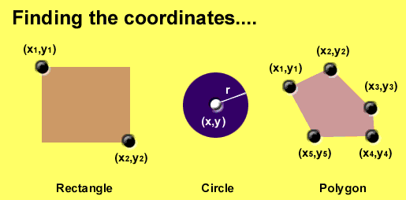
Area Shapes Used

Slide 33
Client-Side Image Maps
Client-side image maps (USEMAP) use a map file that is part of the HTML document (in an element called MAP), and is linked to the image by the Web browser.
<IMG SRC="note.GIF" Width=200 Height=200
border="5" USEMAP="#map1">
<MAP NAME="map1">
<AREA SHAPE="RECT" COORDS="0,0,90,90"
HREF="hi.html" ALT="see me…">
<AREA SHAPE="RECT" COORDS="100,100,160,160"
HREF="divPara.html" ALT="see him…" >
<AREA SHAPE="CIRCLE" COORDS="150,50,20"
HREF="house.html" ALT="see it…" >
</MAP>
We can use Poly as well as Rect……

Slide 34
Shapes, Coords
Types of Shapes
Rect → used for squares and ordered shapes.
Circle → used for circles.
Poly → used for unordered shapes.
Number of coordenations for each shape:
Rect →4 numbers for two corners
Circle →3 numbers for the center & R
Poly → depends on the number of corners of the shape( 2 numbers for each corner)

Slide 35
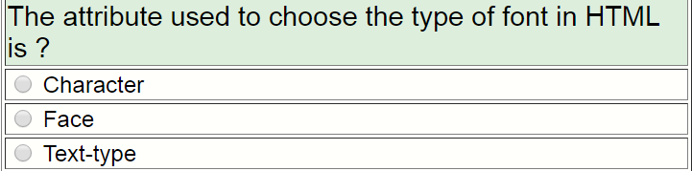
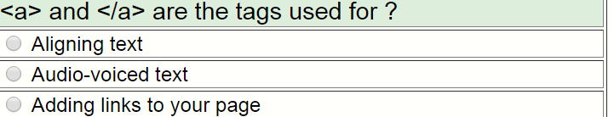
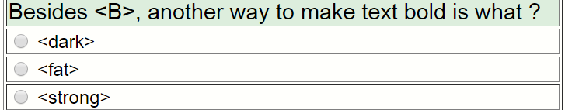

Slide 36
Table
Defining an HTML Table
An HTML table is defined with the <table> tag.
Each table row is defined with the <tr> tag.
A table header is defined with the <th> tag.
By default, table headings are bold and centered.
A table data/cell is defined with the <td> tag.

Slide 37
Tables Attributes
BGColor: Some browsers support background colors in a table.
Width: you can specify the table width as an absolute number of pixels or a percentage of the document width. You can set the width for the table cells as well.
Border: You can choose a numerical value for the border width, which specifies the border in pixels.
CellSpacing: Cell Spacing represents the space between cells and is specified in pixels.

Slide 38
Table Attributes
CellPadding: Cell Padding is the space between the cell border and the cell contents and is specified in pixels.
Align: tables can have left, right, or center alignment.
Background: Background Image, will be titled in IE3.0 and above.
BorderColor, BorderColorDark.

Slide 39
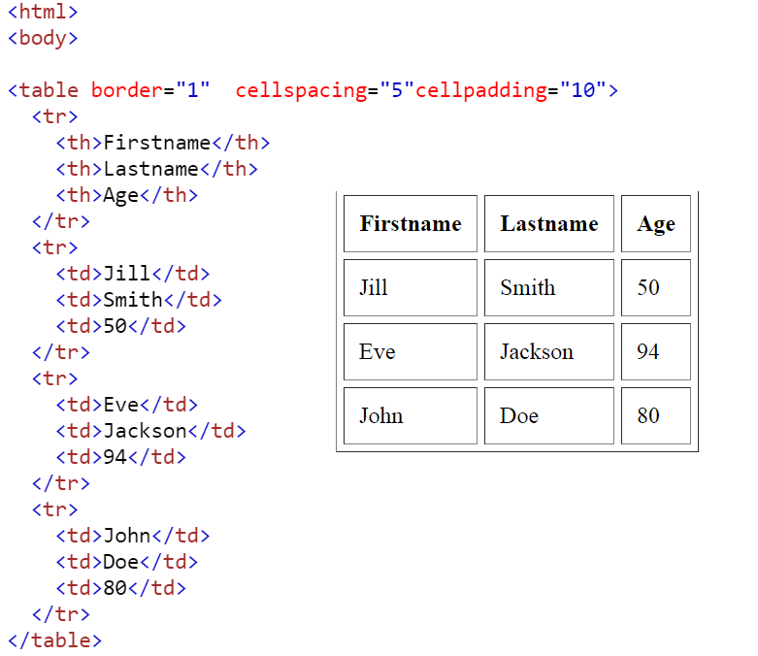
Table

Slide 40
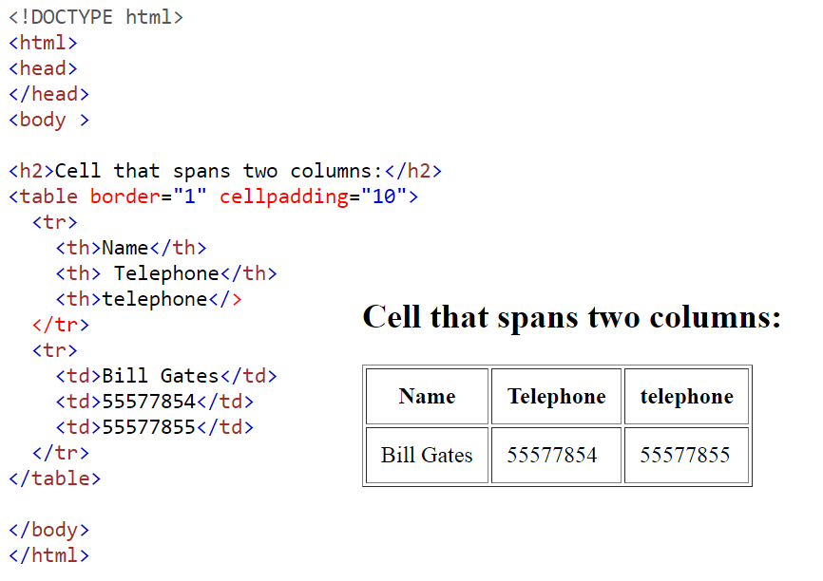

Slide 41
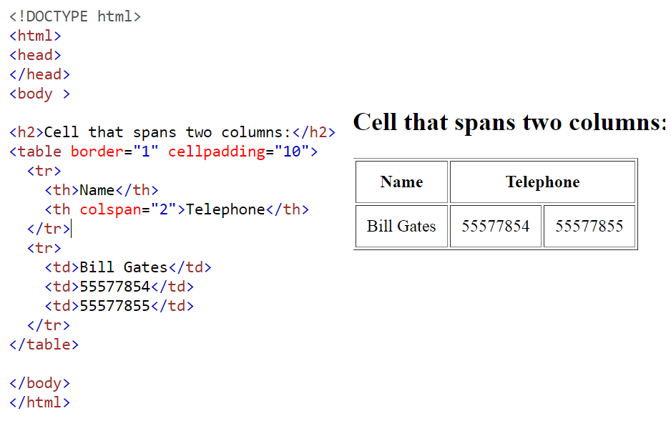
HTML Table - Cells that Span Many Columns
To make a cell span more than one column, use the colspan attribute:

Slide 42
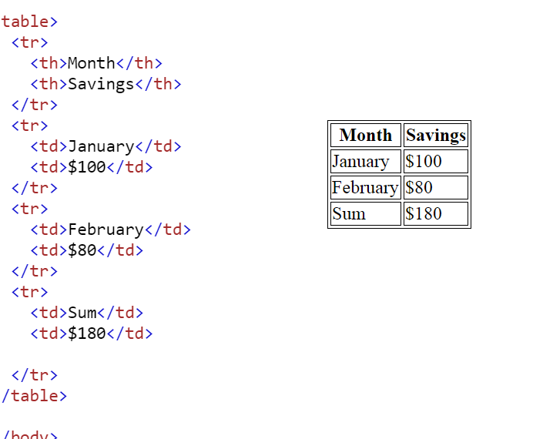

Slide 43
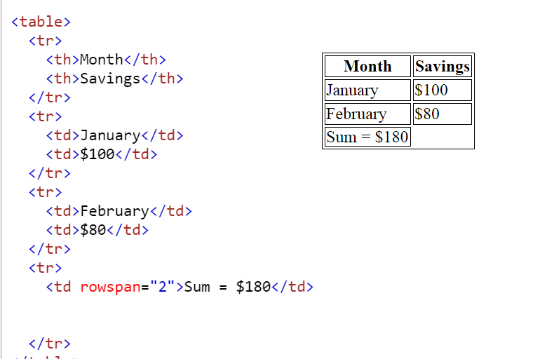

Slide 44
Lists
In this chapter you will learn how to create a variety of lists.
Objectives
Upon completing this section, you should be able to
Create an unordered list.
Create an ordered list.
Create a defined list.
Nest Lists.

Slide 45
List Elements
HTML supplies several list elements. Most list elements are composed of one or more <LI> (List Item) elements.
UL : Unordered List. Items in this list start with a list mark such as a bullet. Browsers will usually change the list mark in nested lists.
<UL>
<LI> List item …</LI>
<LI> List item …</LI>
</UL>
List item …
List item …

Slide 46
List Elements
You have the choice of three bullet types: disc(default), circle, square.
These are controlled in Netscape Navigator by the “TYPE” attribute for the <UL> element.
<UL TYPE=“square”>
<LI> List item …</LI>
<LI> List item …</LI>
<LI> List item …</LI>
</UL>
List item …
List item …
List item …

Slide 47
List Elements
OL: Ordered List. Items in this list are numbered automatically by the browser.
<OL>
<LI> List item …</LI>
<LI> List item …</LI>
<LI> List item …</LI>
</OL>
List item …
List item …
List item
You have the choice of setting the TYPE Attribute to one of five numbering styles.

Slide 48
List Elements
TYPE | Numbering | Styles
1 | Arabic numbers | 1,2,3, ……
a | Lower alpha | a, b, c, ……
A | Upper alpha | A, B, C, ……
i | Lower roman | i, ii, iii, ……
I | Upper roman | I, II, III, ……

Slide 49
List Elements
You can specify a starting number for an ordered list.
<OL TYPE =“i”>
<LI> List item …</LI>
<LI> List item …</LI>
</OL>
<P> text ….</P>
<OL TYPE=“i” START=“3”>
<LI> List item …</LI>
</OL>

Slide 50
List Elements
List item …
List item …
Text ….
List item …

Slide 51
List Elements
DL: Definition List. This kind of list is different from the others. Each item in a DL consists of one or more Definition Terms (DT elements), followed by one or more Definition Description (DD elements).
<DL>
<DT> HTML </DT>
<DD> Hyper Text Markup Language </DD>
<DT> DOG </DT>
<DD> A human’s best friend!</DD>
</DL>
HTML
Hyper Text Markup Language
DOG
A human’s best friend!

Slide 52
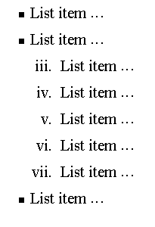
Nesting Lists
You can nest lists by inserting a UL, OL, etc., inside a list item (LI).
EXample
<UL TYPE = “square”>
<LI> List item …</LI>
<LI> List item …
<OL TYPE=“i” START=“3”>
<LI> List item …</LI>
<LI> List item …</LI>
<LI> List item …</LI>
<LI> List item …</LI>
<LI> List item …</LI>
</OL>
</LI>
<LI> List item …</LI>
</UL>

Slide 53
What will be the output?
<H1 ALIGN="CENTER">SAFETY TIPS FOR CANOEISTS</H1> <OL TYPE=“a” START=“2”> <LI>Be able to swim </LI> <LI>Wear a life jacket at all times </LI> <LI>Don't stand up or move around. If canoe tips,
<UL> <LI>Hang on to the canoe </LI> <LI>Use the canoe for support and </LI> <LI>Swim to shore </UL> </LI>
<LI>Don't overexert yourself </LI> <LI>Use a bow light at night </LI> </OL>

Slide 54
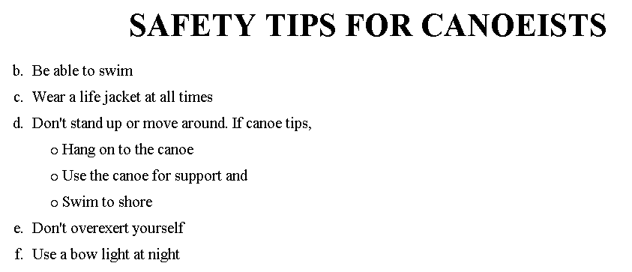
The output….

Slide 55
<H1 ALIGN="CENTER">SAFETY TIPS FOR CANOEISTS</H1>
<OL TYPE="a" START="2">
<LI>Be able to swim </LI>
<LI>Wear a life jacket at all times </LI>
<LI>Don't stand up or move around. If canoe tips,
<UL>
<LI>Hang on to the canoe </LI>
<LI>Use the canoe for support
<OL type="I" start="4">
<LI> Be careful </LI>
<LI> Do not look around</LI>
</LI> </OL>
<LI>Swim to shore
</UL> </LI>
<LI>Don't overexert yourself </LI>
<LI>Use a bow light at night </LI>
</OL>
What
will
be the
output?

Slide 56
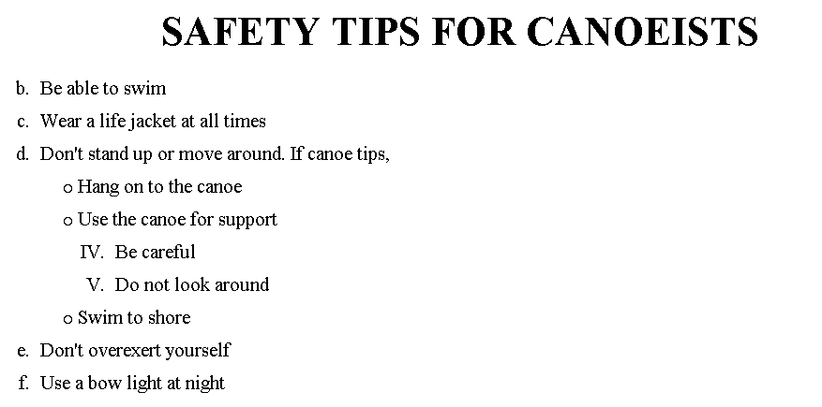
The output….

Slide 57
HTML -FRAME
HTML frames are used to divide your browser window into multiple sections where each section can load a separate HTML document.
A collection of frames in the browser window is known as a frameset.
The window is divided into frames in a similar way the tables are organized: into rows and columns.

Slide 58
HTML -Frameset
Definition and Usage
The <frameset> tag is not supported in HTML5.
The <frameset> tag defines a frameset.
The <frameset> element holds one or more <frame> elements.
Each <frame> element can hold a separate document.
The <frameset> element specifies HOW MANY columns or rows there will be in the frameset, and HOW MUCH percentage/pixels of space will occupy each of them.

Slide 59
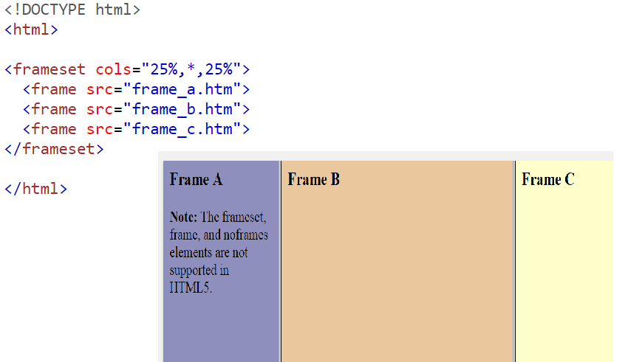
HTML -Frameset

Slide 60
HTML -Frameset
Disadvantages of Frames
There are few drawbacks with using frames, so it's never recommended to use frames in your webpages:
Some smaller devices cannot cope with frames often because their screen is not big enough to be divided up.
Sometimes your page will be displayed differently on different computers due to different screen resolution.
The browser's back button might not work as the user hopes.
There are still few browsers that do not support frame technology.

Slide 61
HTML -Frameset
Frame's name and target attributes
One of the most popular uses of frames is to place navigation bars in one frame and then load main pages into a separate frame.
Let's see following example where a test.htm file has following code:
<!DOCTYPE html>
<html>
<head>
<title>HTML Target Frames</title>
</head>
<frameset cols="200, *">
<frame src="/html/menu.htm" name="menu_page" />
<frame src="/html/main.htm" name="main_page" />
<noframes>
<body>
Your browser does not support frames.
</body>
</noframes>
</frameset>
</html>

Slide 62
Following is the content of menu.htm file
<!DOCTYPE html>
<html>
<body bgcolor="#4a7d49">
<a href="https://www.google.com" target="main_page">Google</a>
<br /><br />
<a href="https://www.microsoft.com" target="main_page">Microsoft</a>
<br /><br />
<a href="https://news.bbc.co.uk" target="main_page">BBC News</a>
</body>
</html>

Slide 63
Following is the content of main.htm file:
<!DOCTYPE html>
<html>
<body bgcolor="#b5dcb3">
<h3>This is main page and content from any link will be displayed here.</h3>
<p>So now click any link and see the result.</p>
</body>
</html>

Slide 65
When we load test.htm file, it produces following result:
Frame Target Attribute
Now you can try to click links available in the left panel and see the result. The target attribute can also take one of the following values:
Option Description
_self Loads the page into the current frame.
_blank Loads a page into a new browser window.opening a new window.
_parent Loads the page into the parent window, which in the case of a single frameset is the main browser window.
_top Loads the page into the browser window, replacing any current frames.
targetframe Loads the page into a named targetframe.

Slide 66
The <form> Element
The HTML <form> element defines a form that is used to collect user input:
Syntax
<form> . form elements . </form>
An HTML form contains form elements.
Form elements are different types of input elements, like text fields, checkboxes, radio buttons, submit buttons, and more.

Slide 67
The <input> Element
The <input> element is the most important form element.
The <input> element can be displayed in several ways, depending on the type attribute.
Here are some examples:
Type | Description
<input type="text"> | Defines a one-line text input field
<input type="radio"> | Defines a radio button (for selecting one of many choices)
<input type="submit"> | Defines a submit button (for submitting the form)

Slide 68
<!DOCTYPE html>
<html>
<body>
<form>
First name:<br>
<input type="text" name="firstname“ size=“30”>
<br>
Last name:<br>
<input type="text" name="lastname">
</form>
<p>Note that the form itself is not visible.</p>
<p>Also note that the default width of a text input field is 20 characters.</p>
</body>
</html>

Slide 69
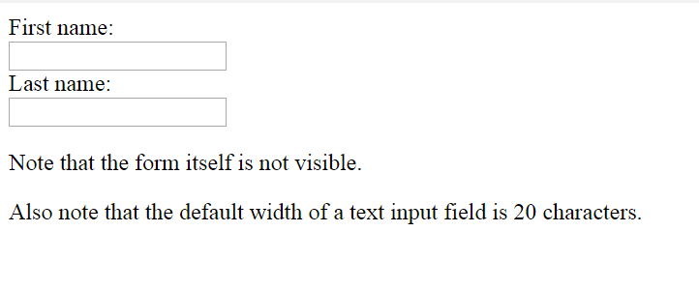

Slide 70
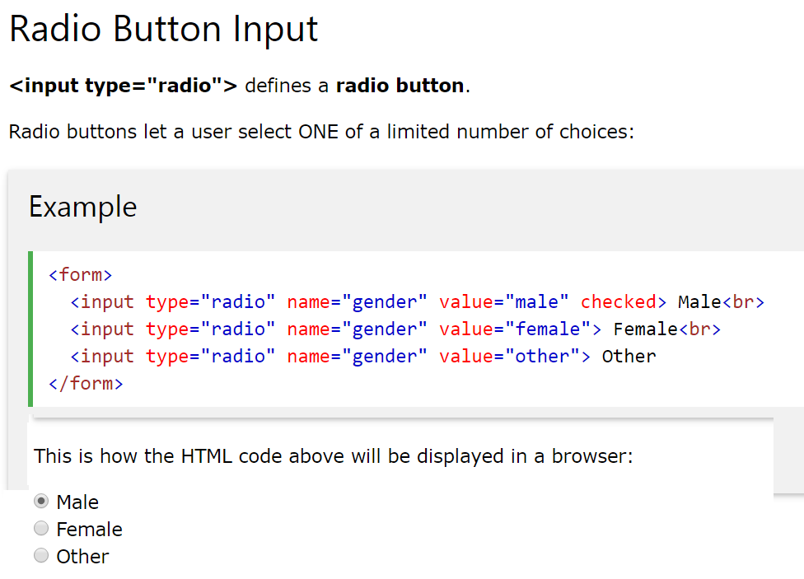

Slide 71
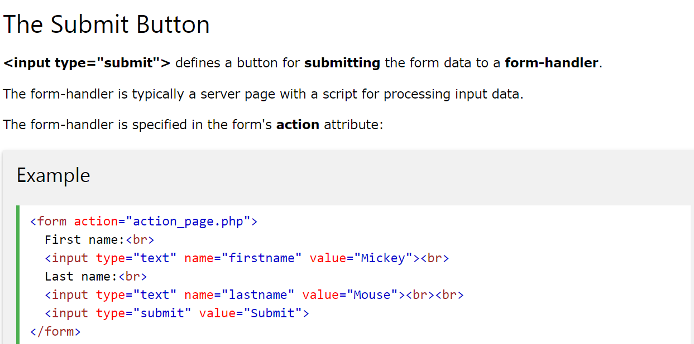

Slide 72
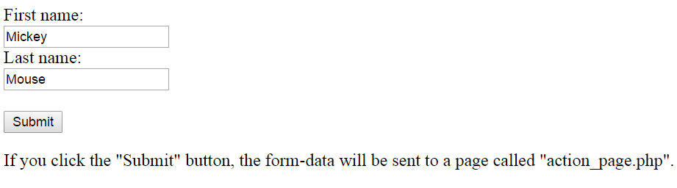

Slide 73
Grouping form data
Grouping Form Data with <fieldset>
The <fieldset> element is used to group related data in a form.
The <legend> element defines a caption for the <fieldset> element.

Slide 74
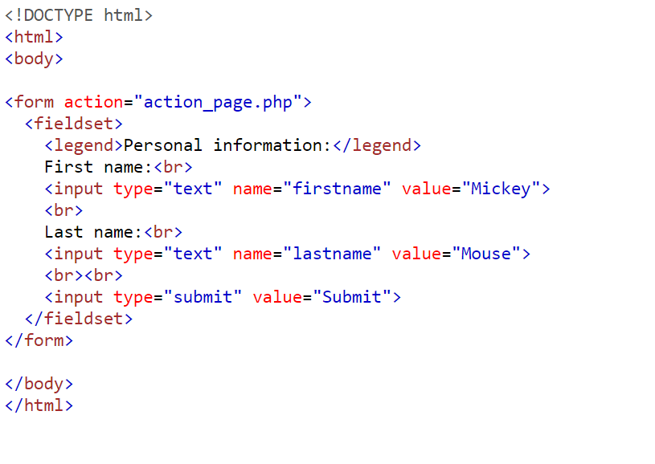

Slide 75
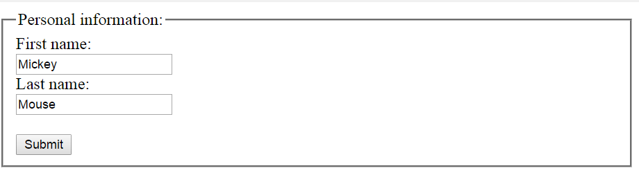

Slide 76
drop-down list
The <select> Element
The <select> element defines a drop-down list:
Example
<select name="cars"> <option value="volvo">Volvo</option> <option value="saab">Saab</option> <option value="fiat">Fiat</option> <option value="audi">Audi</option> </select>

Slide 77
drop-down list
The <option> elements defines an option that can be selected.
By default, the first item in the drop-down list is selected.
To define a pre-selected option, add the selected attribute to the option:
Example
<option value="fiat" selected>Fiat</option>

Slide 78
drop-down list
The <button> Element:-
The <button> element defines a clickable button:
Example

Slide 79
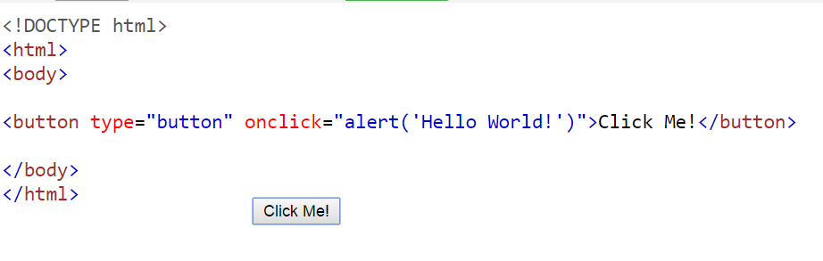
button

Slide 80
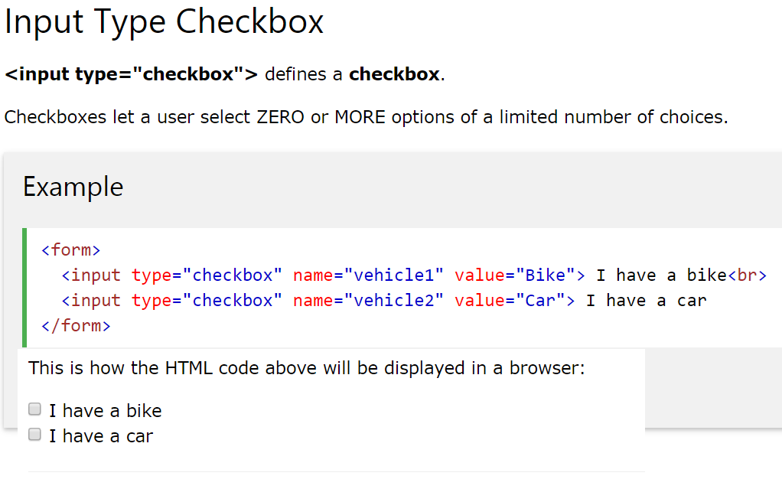

Slide 81
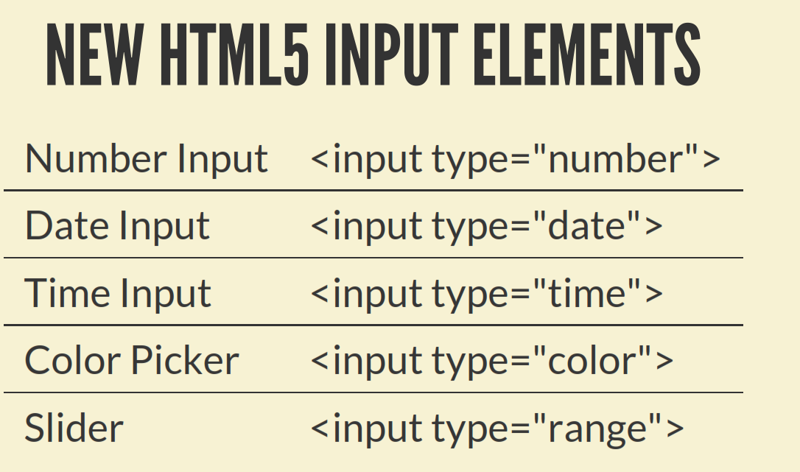

Slide 82
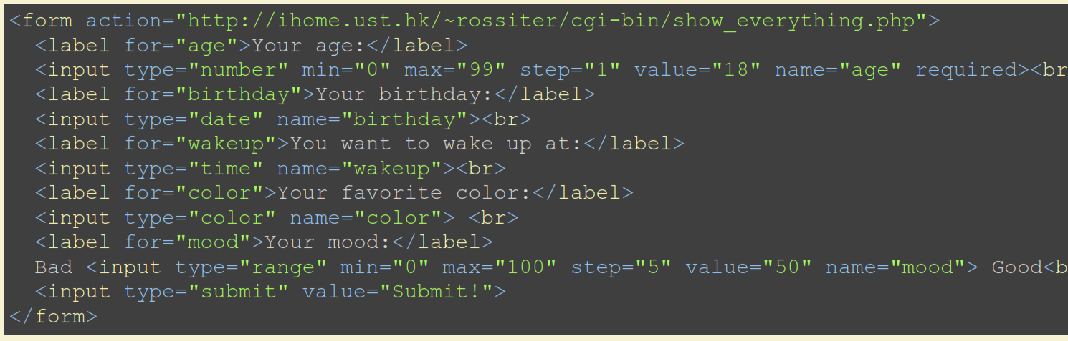

Slide 83
